Slide 1

Welcome to the music

Slide 2
Pop
Classical
Rock & Roll

Slide 3


Pop
0
8

Slide 4

What is pop music?

Slide 5


The development of
Chinese pop music

Slide 6
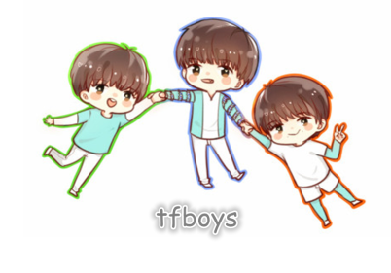
my favorite！

Slide 7
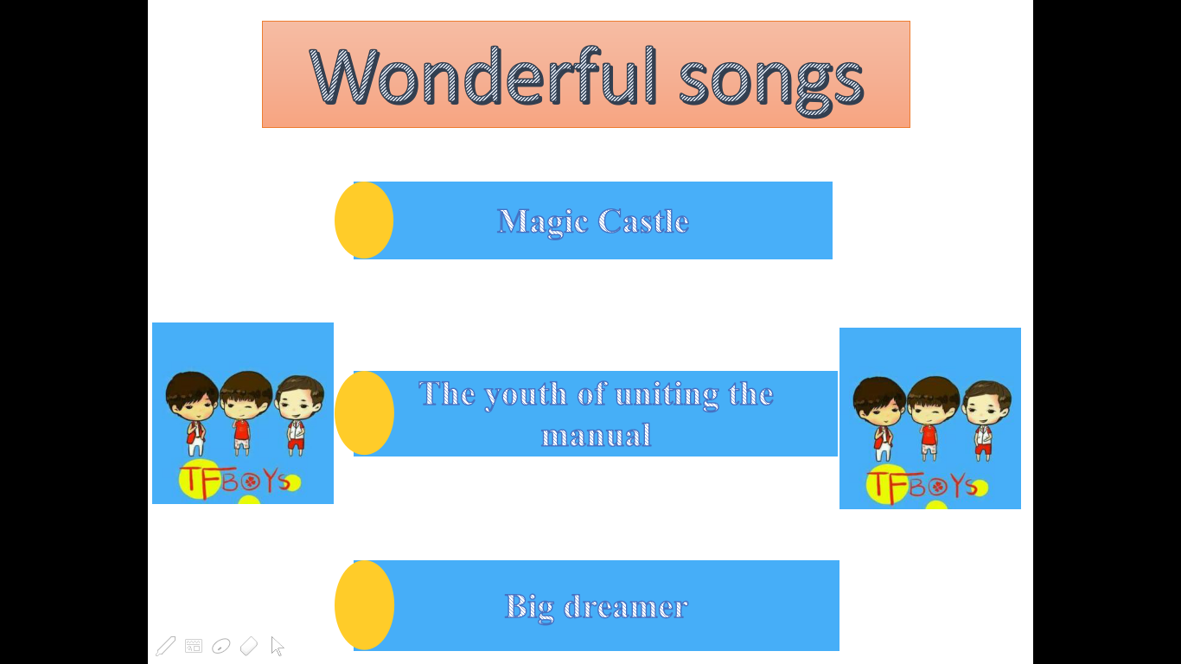

Wonderful songs
Magic Castle
The youth of uniting the manual
Big dreamer

Slide 8

Wonderful songs
Magic Castle
青春修炼册
Big dreamer

Slide 9
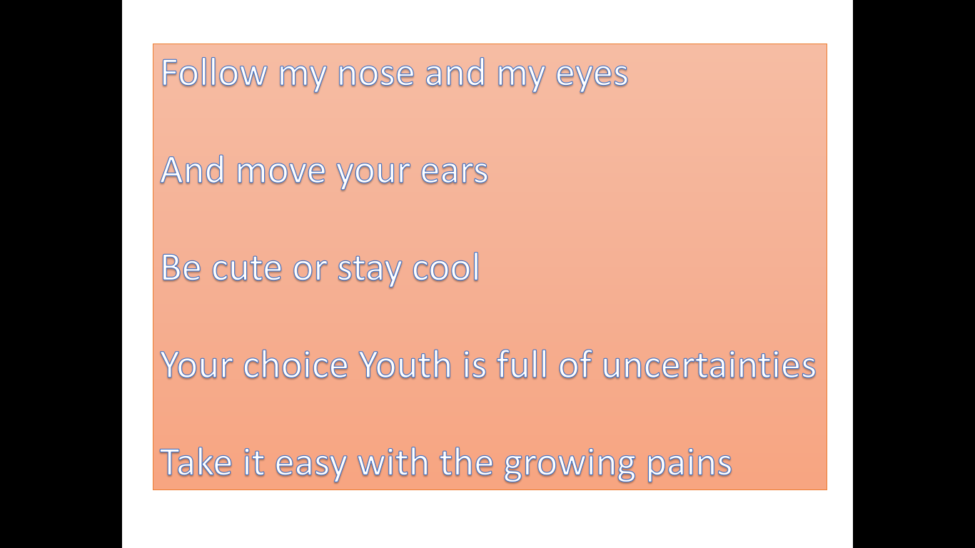
Follow my nose and my eyes
And move your ears
Be cute or stay cool
Your choice Youth is full of uncertainties
Take it easy with the growing pains

Slide 10

Why do i love pop?

Slide 11


Classical

Slide 12
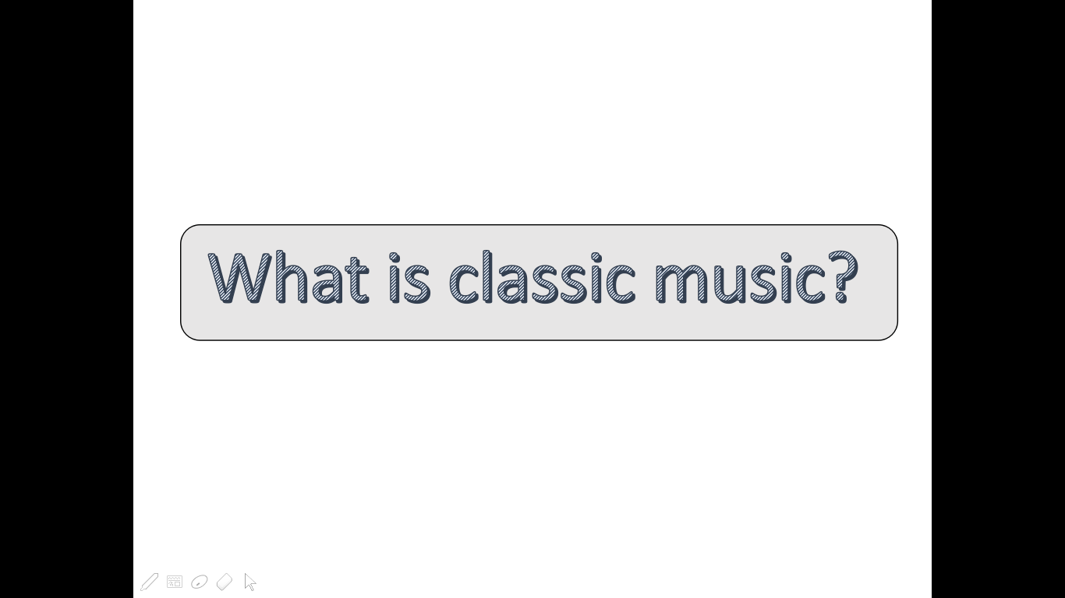
What is classic music?

Slide 13
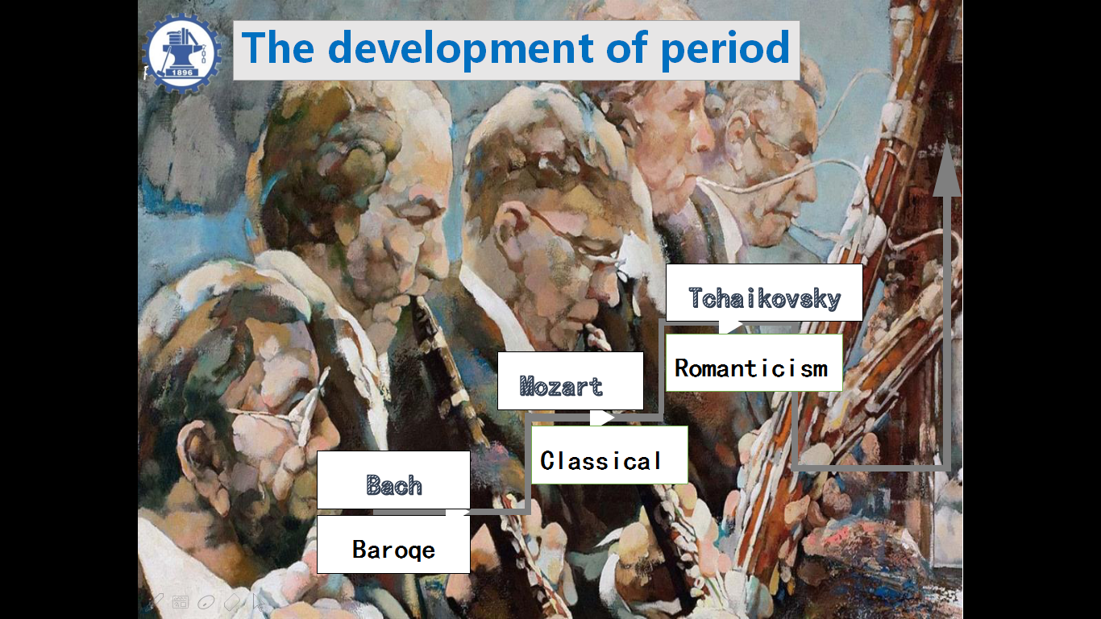
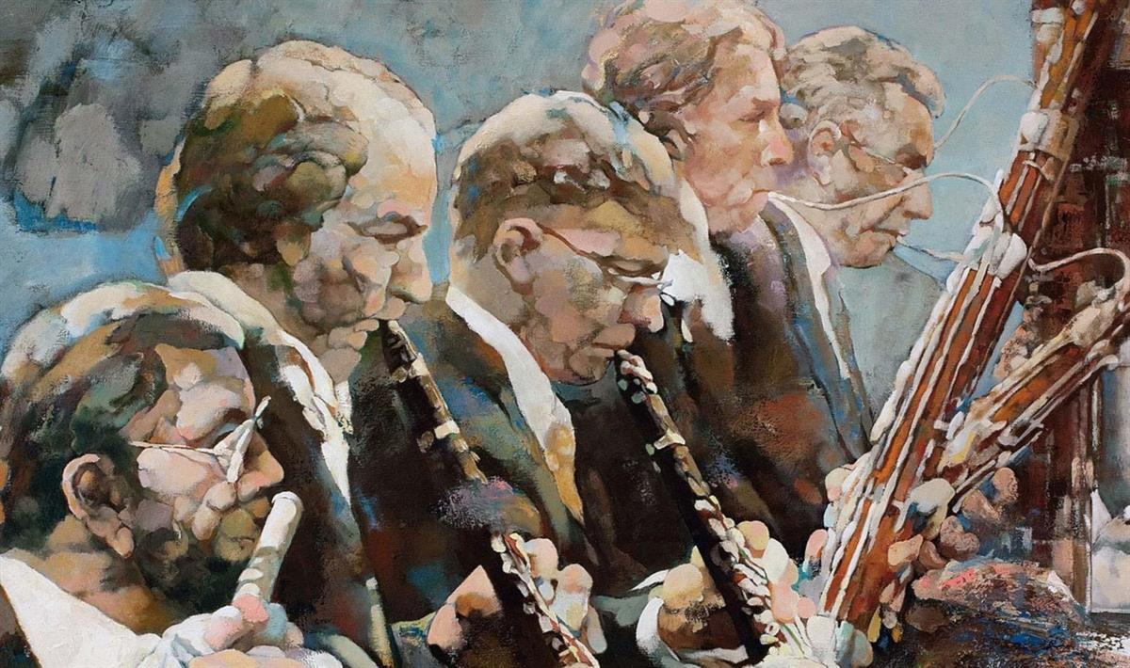
2
The development of period
PART
Tchaikovsky
Romanticism
Mozart
Classical
Bach
Baroqe

Slide 14
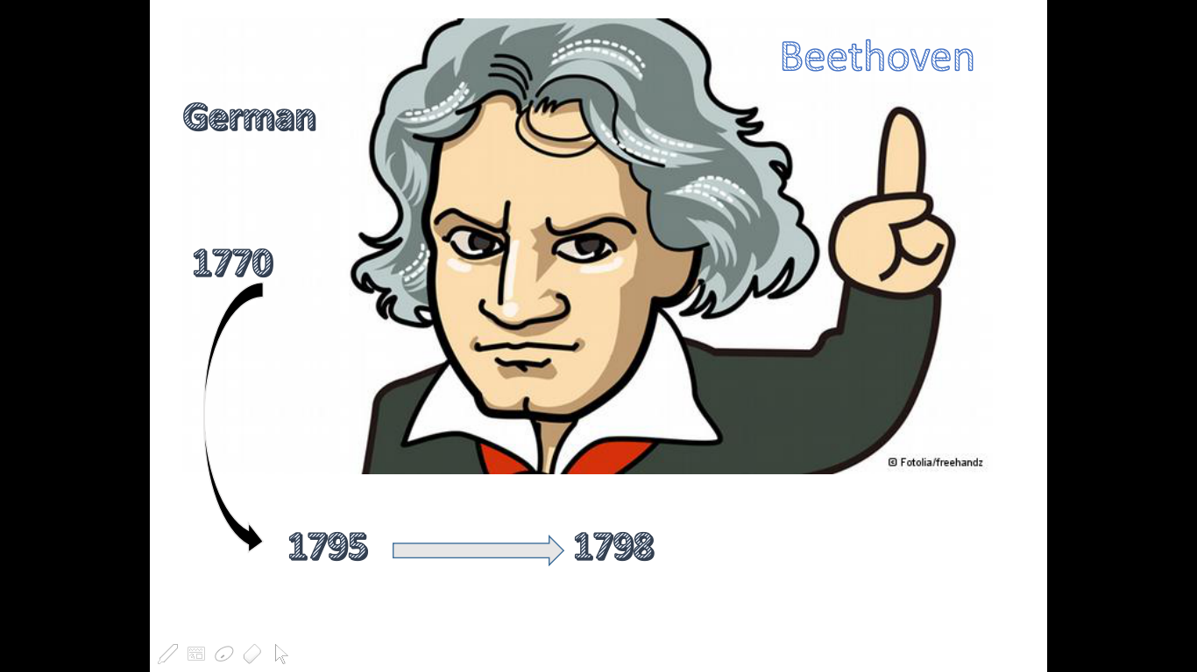
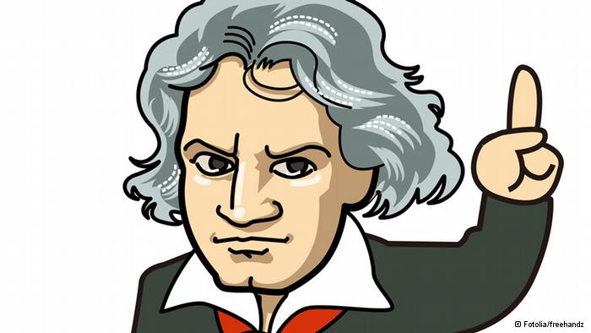
Beethoven
German
1770
1795
1798

Slide 15
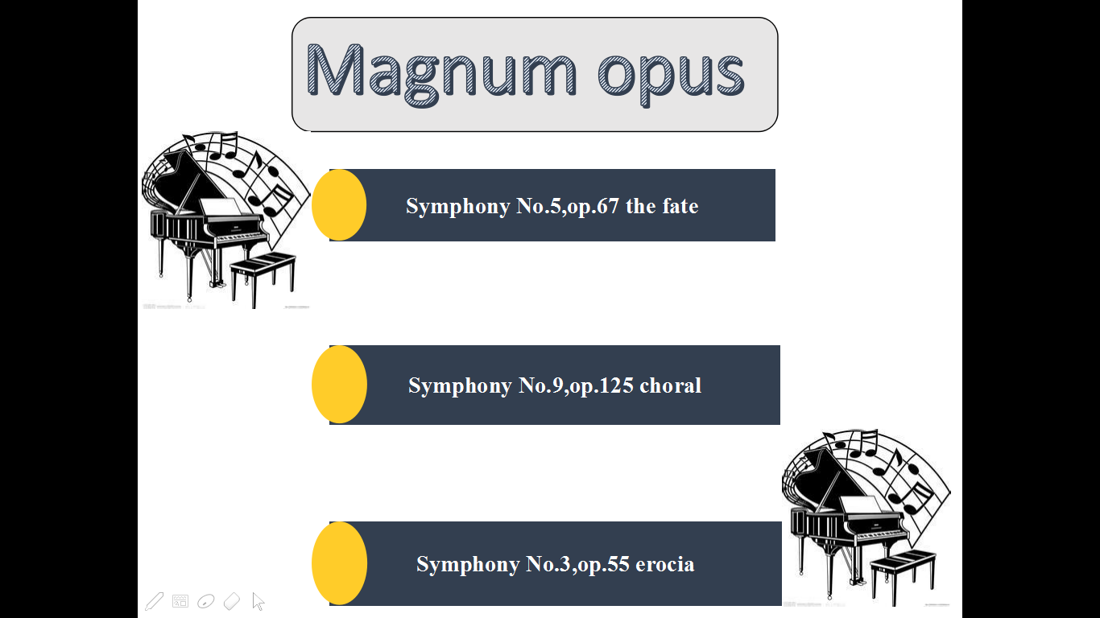

Magnum opus
Symphony No.5,op.67 the fate
Symphony No.9,op.125 choral
Symphony No.3,op.55 erocia

Slide 16
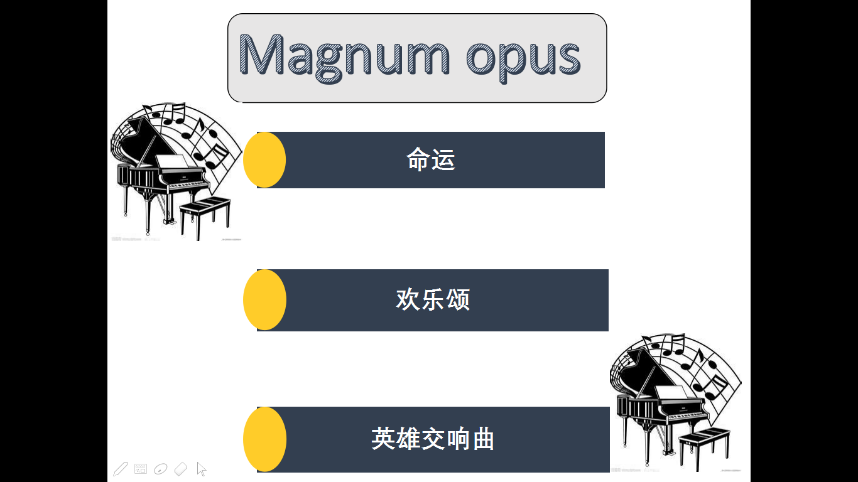
Magnum opus
命运
欢乐颂
英雄交响曲

Slide 17
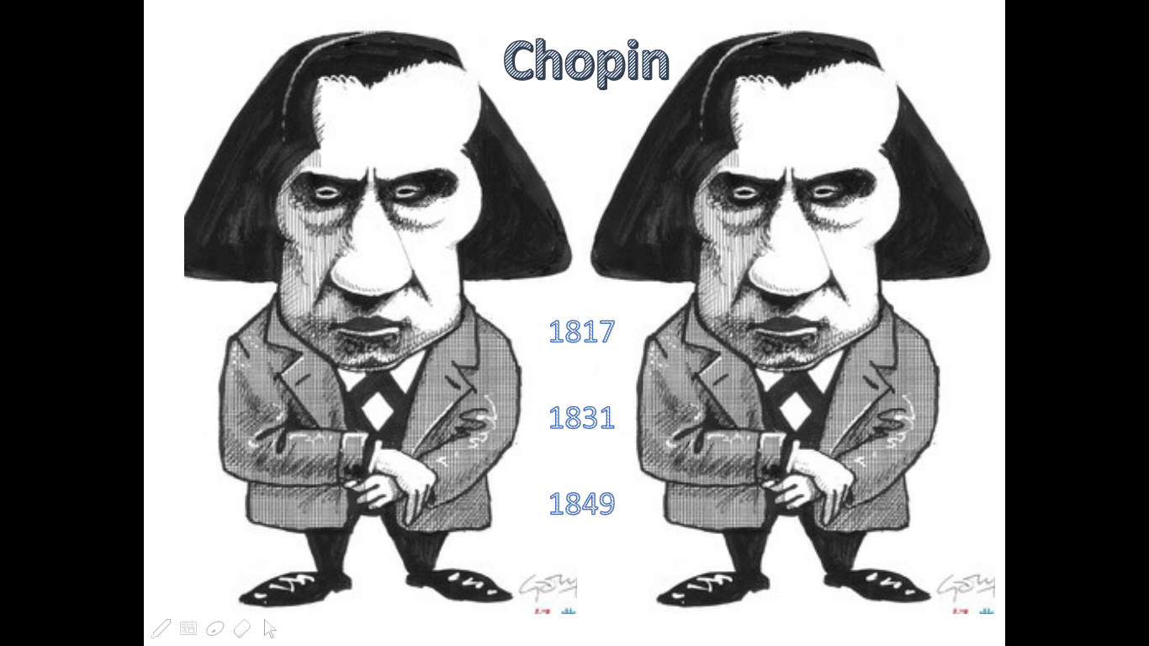
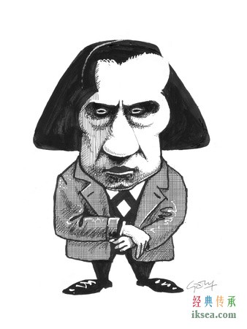
Chopin
1817
1831
1849

Slide 18

Magnum opus
Op.9.No.1.noturnes
Minute Waltz
Op.33.No.2 mazuka

Slide 19
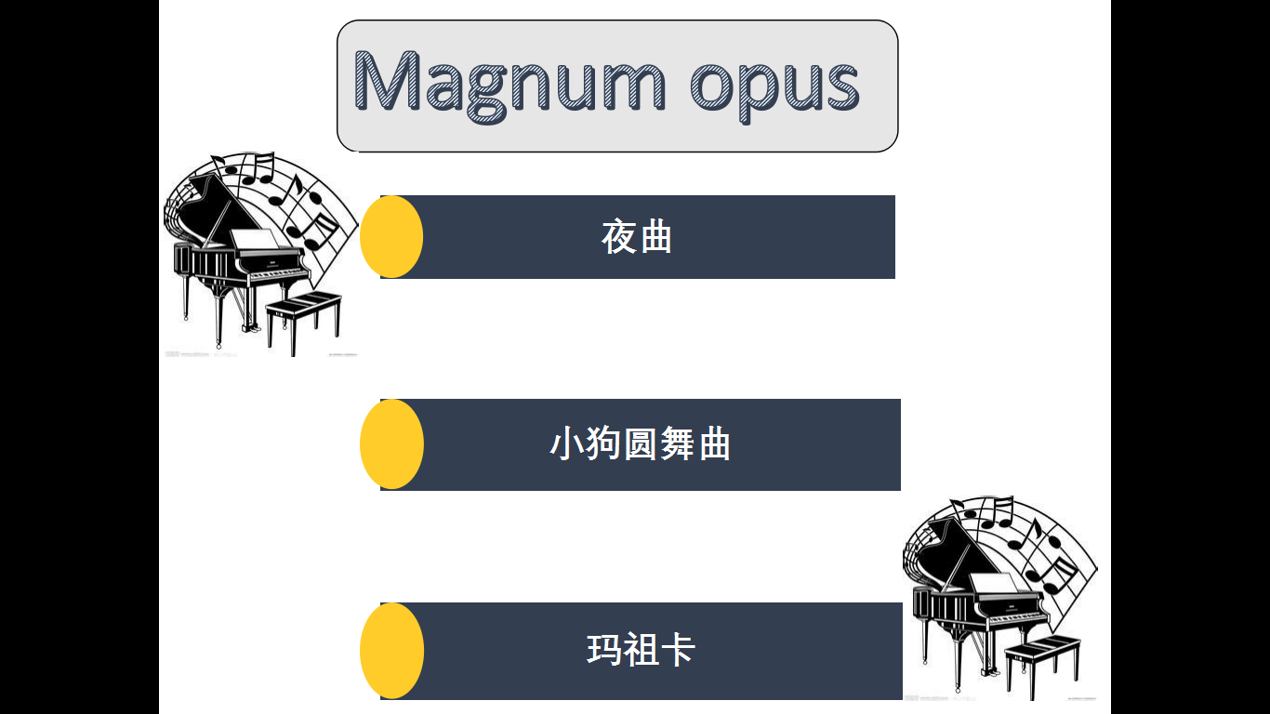
Magnum opus
夜曲
小狗圆舞曲
玛祖卡

Slide 20

Why do i love classical?

Slide 21



Rock & Roll

Slide 22




Music form
Attitude & Spirit

Slide 23
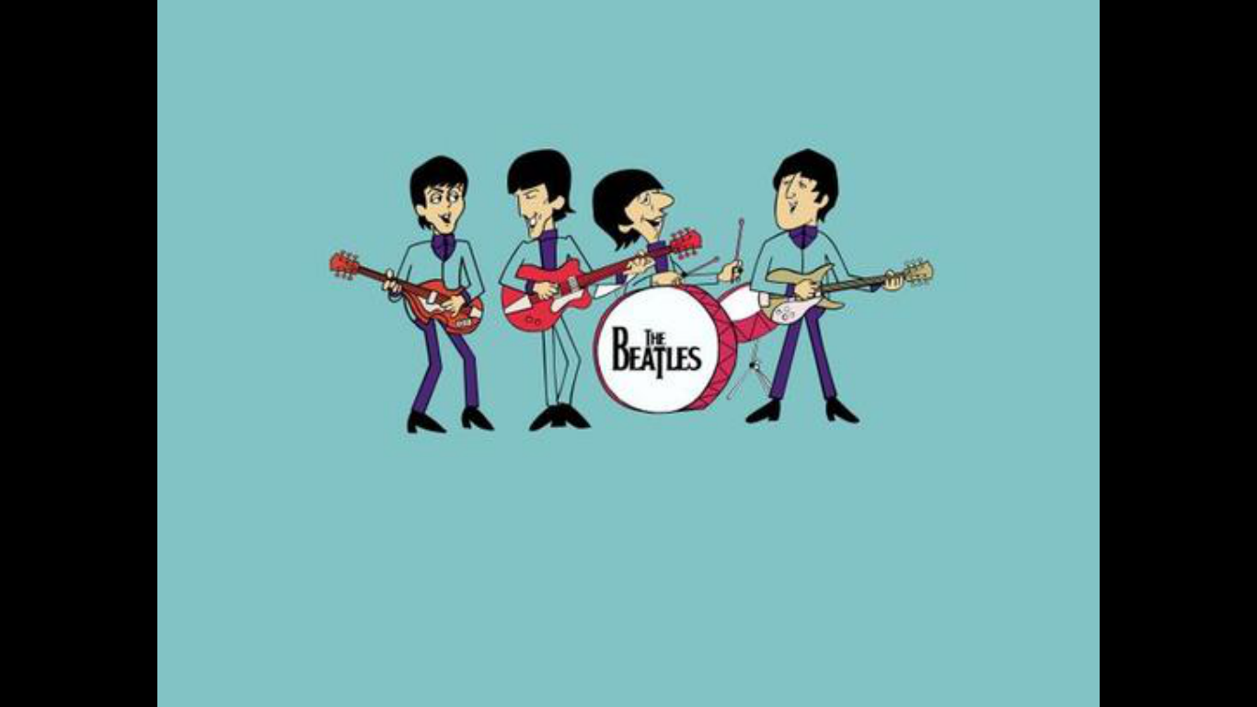
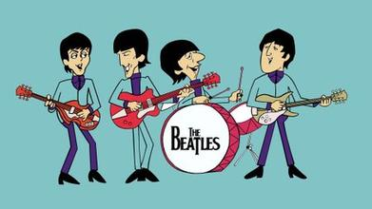

Slide 24
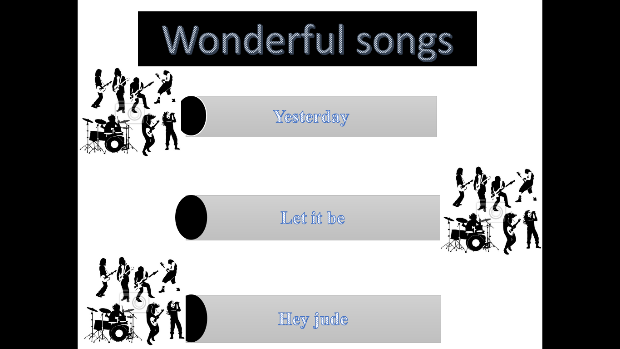

Wonderful songs
Yesterday
Let it be
Hey jude

Slide 25



Slide 26





Dylan and his prizes
The Grammy
The Academy Awards
The Golden Globes
The Pulitzer Prize

Slide 27


Slide 28
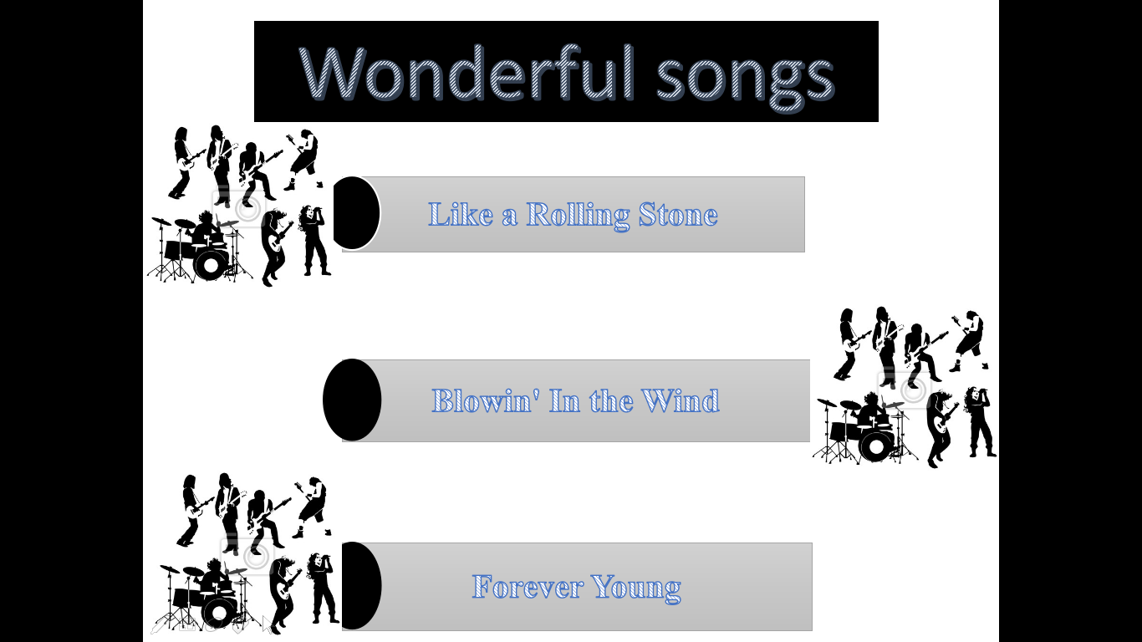
Wonderful songs
Like a Rolling Stone
Blowin' In the Wind
Forever Young

Slide 29
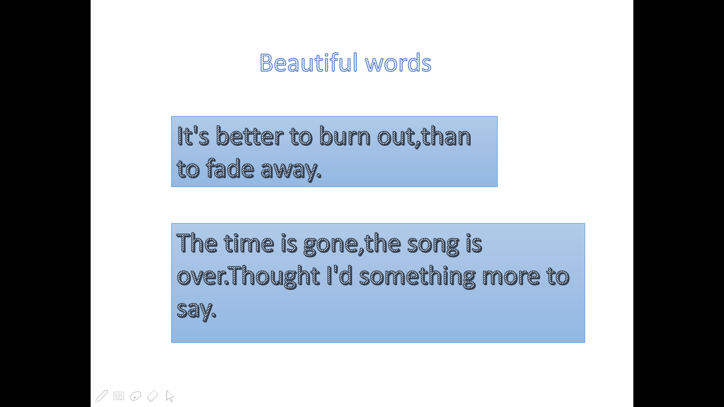
Beautiful words
It's better to burn out,than to fade away.
The time is gone,the song is over.Thought I'd something more to say.

Slide 30


Why do i love Rock&Roll?

Slide 31
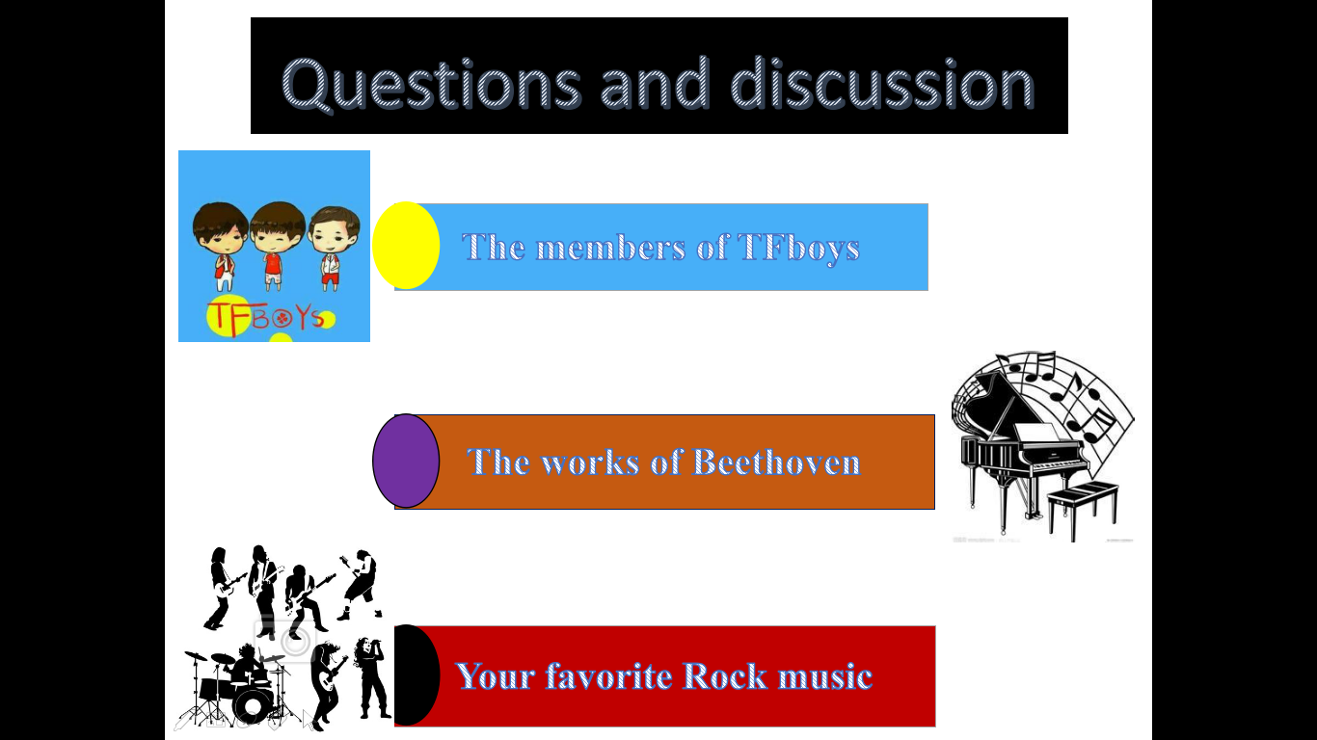
Questions and discussion
The members of TFboys
The works of Beethoven
Your favorite Rock music

Slide 32
Thanks!
2017/01/07

